Slide 1
Pushdown automata
https://www.tutorialspoint.com/automata_theory/pushdown_automata_introduction.htm

Slide 2
Basic Structure of PDA
A pushdown automaton is a way to implement a context-free grammar in a similar way we design DFA for a regular grammar. A DFA can remember a finite amount of information, but a PDA can remember an infinite amount of information.
Basically a pushdown automaton is −
"Finite state machine" + "a stack"
A pushdown automaton has three components −
an input tape,
a control unit, and
a stack with infinite size.
The stack head scans the top symbol of the stack.
A stack does two operations −
Push − a new symbol is added at the top.
Pop − the top symbol is read and removed.

Slide 3
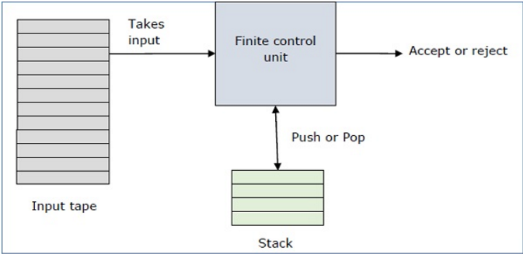
A PDA may or may not read an input symbol, but it has to read the top of the stack in every transition.

Slide 4
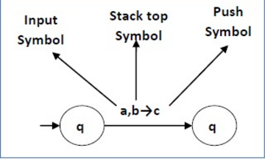
A PDA can be formally described as a 7-tuple (Q, ∑, S, δ, q₀, I, F) −
Q is the finite number of states
∑ is input alphabet
S is stack symbols
δ is the transition function: Q × (∑ ∪ {ε}) × S × Q × S*
q₀ is the initial state (q₀ ∈ Q)
I is the initial stack top symbol (I ∈ S)
F is a set of accepting states (F ∈ Q)
The following diagram shows a transition in a PDA from a state q₁ to state q₂, labeled as a,b → c −

Slide 5
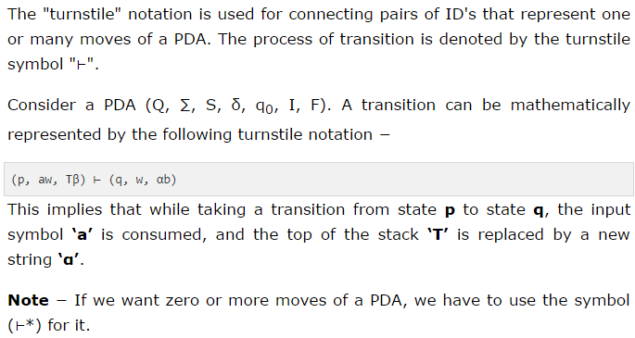
The instantaneous description (ID) of a PDA is represented by a triplet (q, w, s) where
q is the state
w is unconsumed input
s is the stack contents

Slide 6
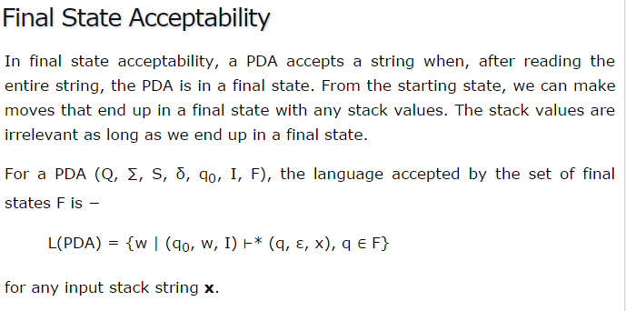

Slide 7
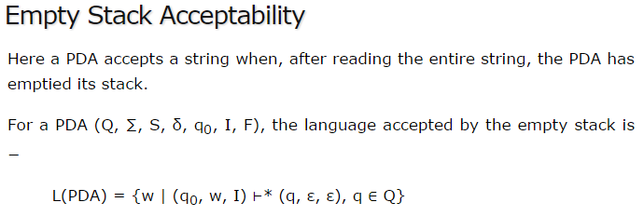

Slide 8
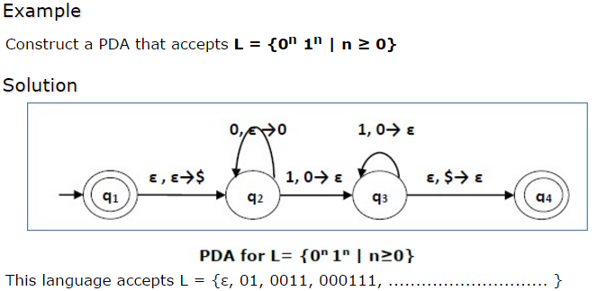
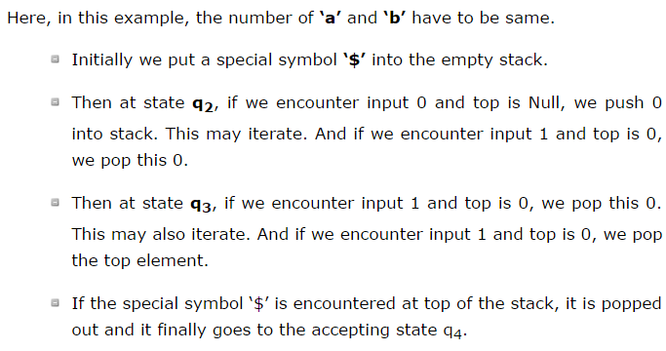

Slide 9
